Slide 1
Store sales forecasting

Slide 2




MEET OUR TEAM
Nasir Abu-Own
Mohammed Al-Mansi
Abbad Zayed
Ultimate Nasir Abu-Own

Slide 3
CONTENTS
Problem Definition and Structuring
Data Analysis
Data Visualizing
Feature Extracting

Slide 4
Problem definition
4
We have 45 stores with a different number of departments. We want to forecast the sales and to analyze the features that are affecting the sales in order to meet the company target.

Slide 5




Problem Structuring
5
Cleaning and preparing data
Analyzing data
Visualizing data and searching for patterns
Choosing primary set of features

Slide 6
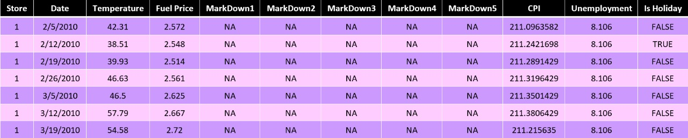
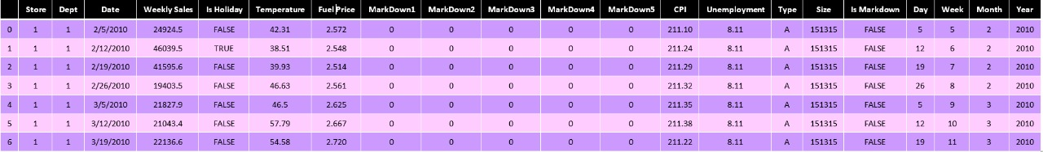

Slide 7
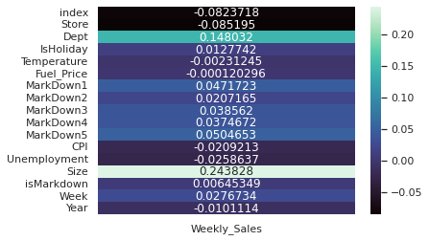
Correlation Matrix

Slide 8
hypotheses
Our motivation for this project is to forecast and to give explanation for the variance in sales depending on other features given to us
We analyzed multiple features in order to select the best possible set of features for the predictive model

Slide 9
hypotheses
Weeks with holidays have a higher average weekly sales
Type A store has higher weekly sales.
Store size and Store type are correlated

Slide 10
hypotheses
Fuel prices, CPI and unemployment have low correlation with the target
There is an optimum Temperature for sales which is expected to be neither hot nor cold
Size has strong correlation with weekly sales

Slide 11
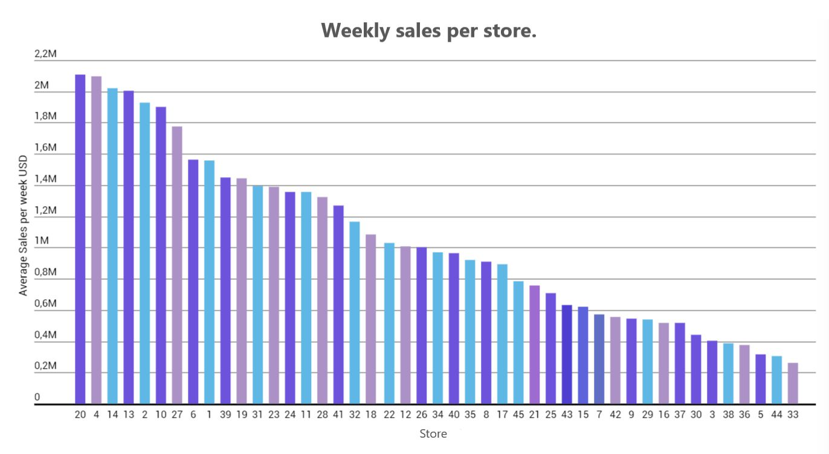
Average Weekly Sales/Store

Slide 12
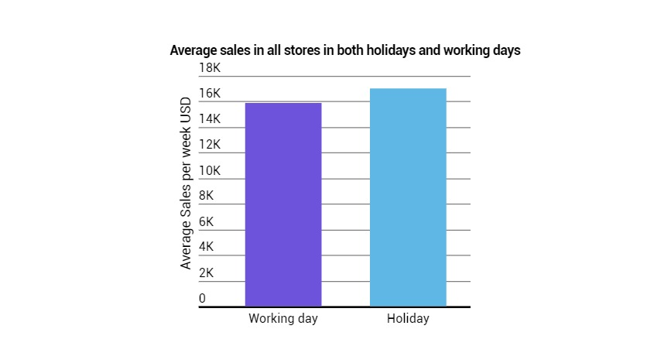
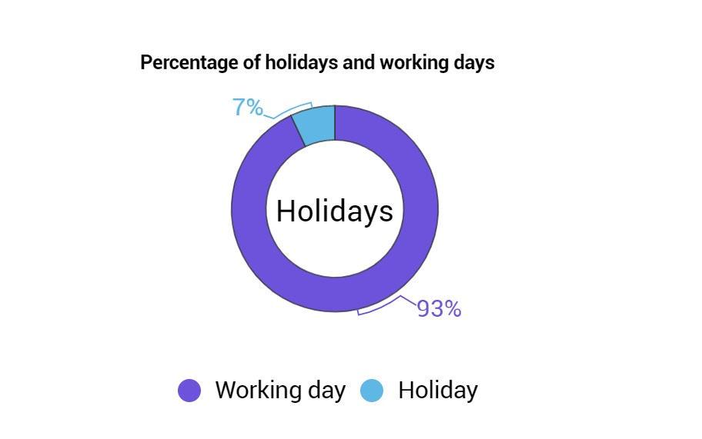
Holidays sales

Slide 13
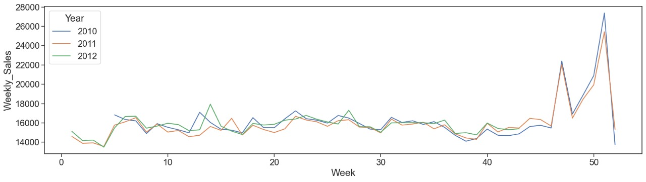
Weekly sales over weeks

Slide 14
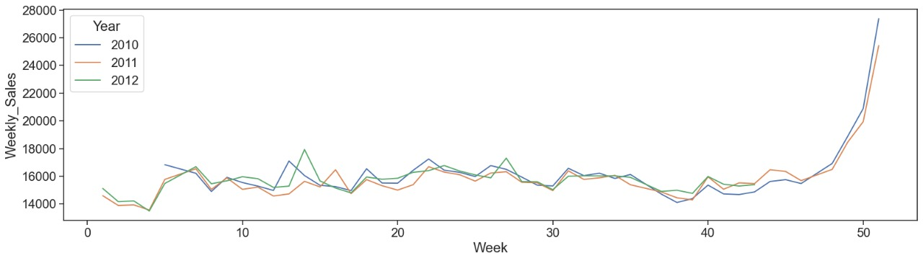
Weekly sales over weeks without holidays feature

Slide 15
Holidays sales
It became apparent that holidays has a significant effect on the target value which confirm the hypothesis we made earlier about having significant correlation between holidays and stores weekly sales

Slide 16
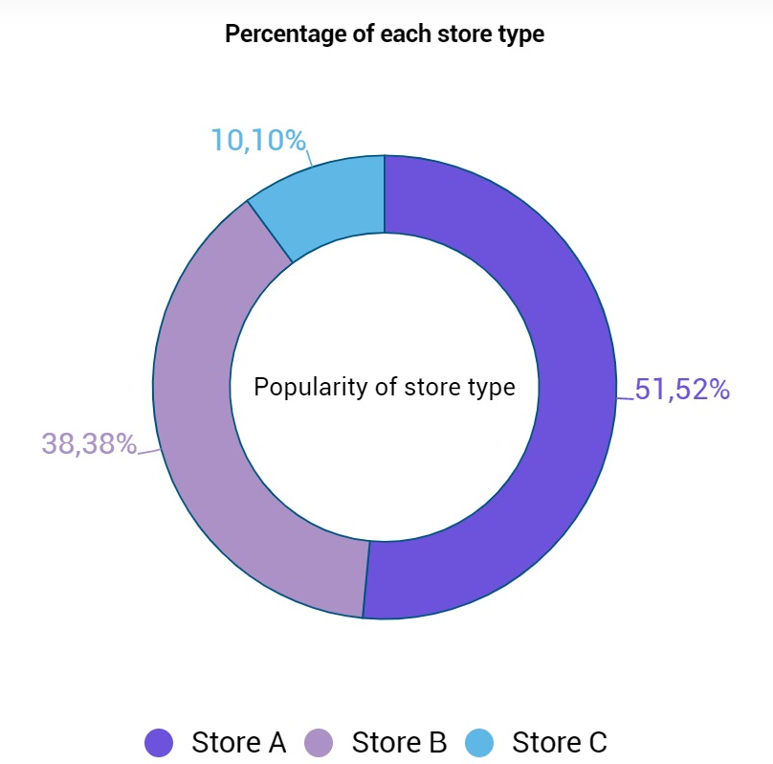
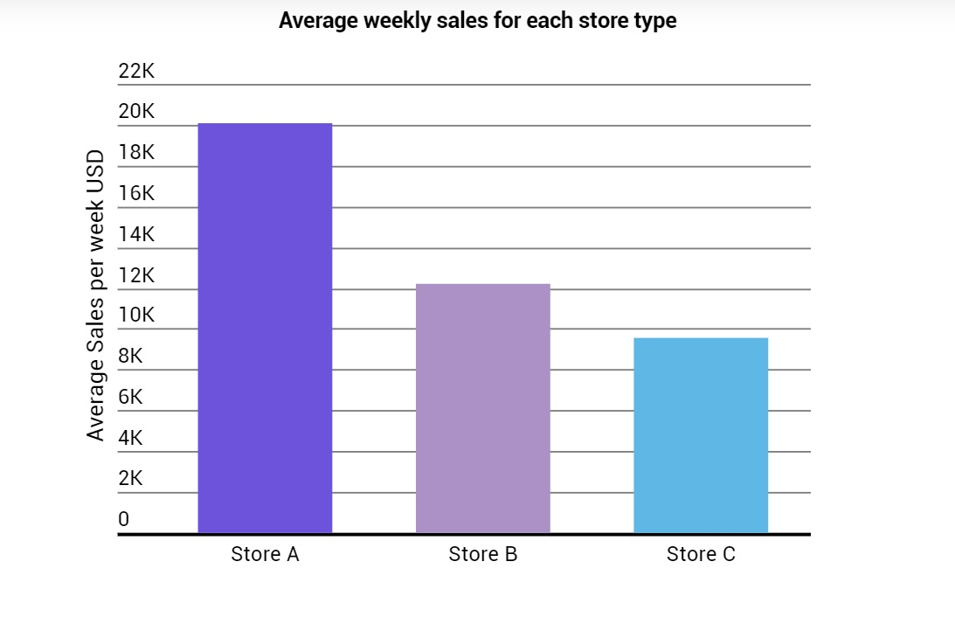
Store types

Slide 17
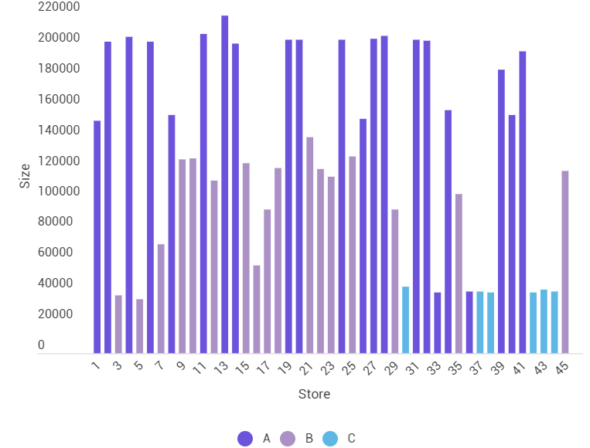
Store and size

Slide 18
Store Type and size
The second hypothesis stated that Stated that Type A stores has higher weekly sales, which was confirmed after the analysis, type A stores had around twice the average Weekly sales compared to Type B & Type C stores.
Meanwhile, the third hypothesis stated Store size and Store type are correlated which was confirmed during the analysis, it was noticed the Type A stores had a significantly higher size compared to the other two types

Slide 19
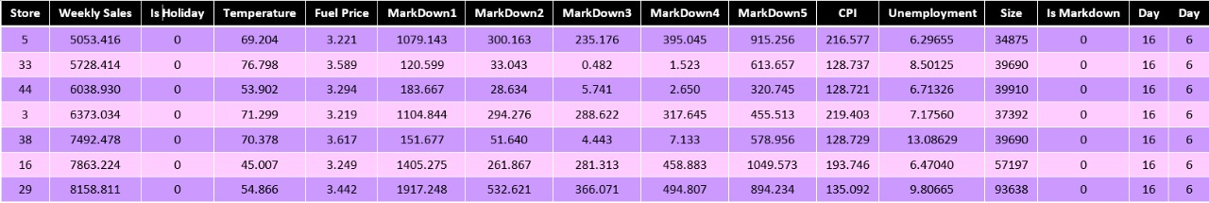
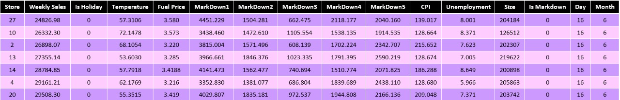
Splitting the data into top/bot on weekly sales

Slide 20
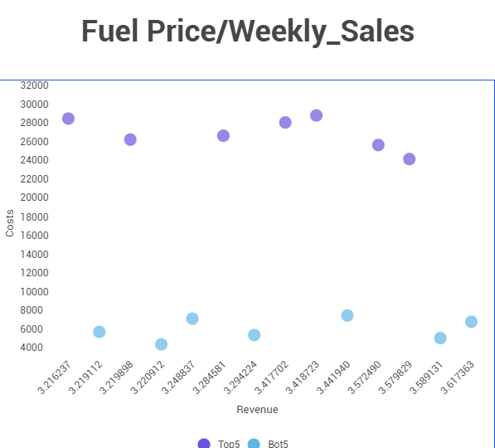
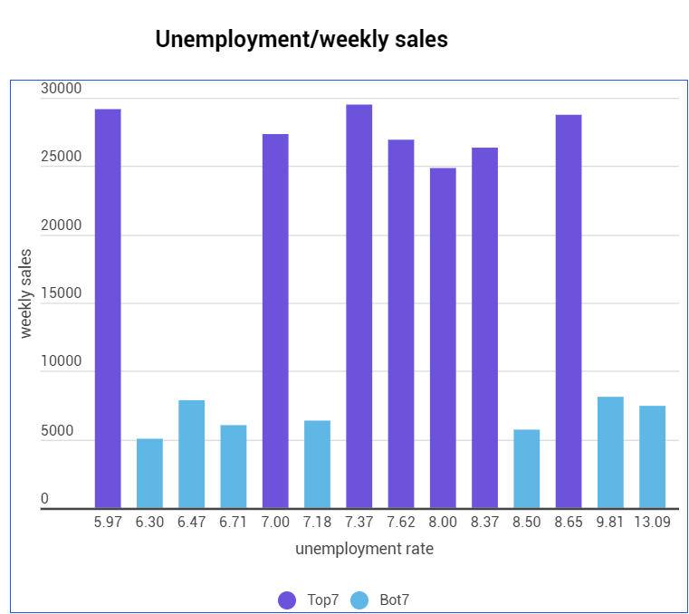
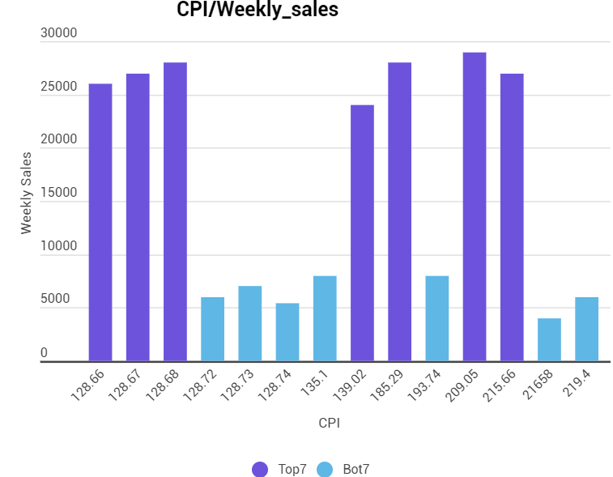
irrelevant data
Fuel Price
Unemployment
CPI

Slide 21
Irrelevant data
The fourth hypothesis stated that “Fuel prices, CPI and unemployment have low correlation with the target” which was proved during the analysis since the increase in them all didn’t follow a clear pattern, as was the shown the graphs had a lot of fluctuations

Slide 22
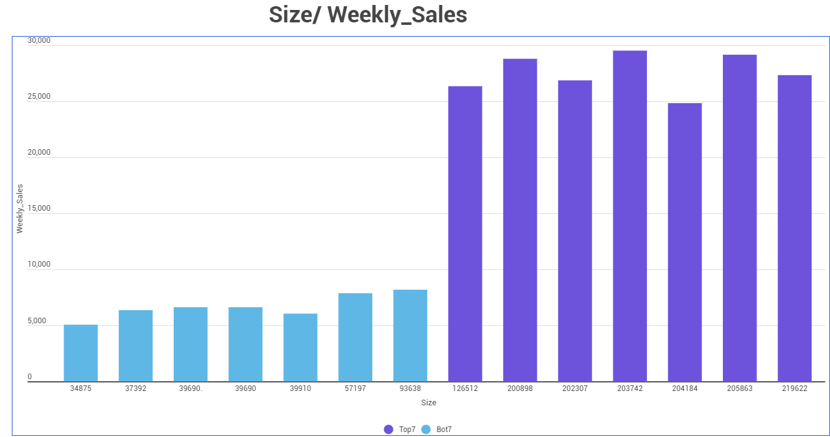
Relevant data

Slide 23
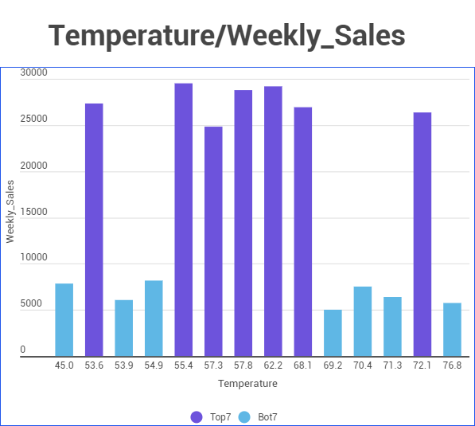
Relevant data

Slide 24
Relevant data
The fifth hypothesis assumed that people prefer to shop at a certain Temperature range which the graph agreed with despite that other factors like holidays might effect it leading to some outliers, the optimum Temperature range was from 55 F֯ (13C֯ ) to 68 F֯ (20C֯ ).
The final hypothesis which stated “Size has strong correlation with weekly sales” which was confirmed since all large stores had much higher weekly sales.

Slide 25
conclusion
Enhancing feature selection by removing the redundant features by studying the correlation between the features set. Two features were removed {Markdown3 , Markdown5}because they had high correlation with other features.
Unemployment was dropped due its low correlation with the weekly sales.
We confirmed the two predicted features during the analysis{Temperatures, is holiday}. Meanwhile store type was dropped due to the correlation with Size.
The final set included 6 features {Size, Markdown3, Markdown5, Temperatures, is holiday, Week}

Slide 26
Part2
19
Wait for us in part 2 for the modeling and feature extracting to understand more about the sales forecasting.
Thank you all for listening

Slide 27
THANK YOU
Orange Coding Academy
Coach Deena Al-Abed
Coach Aya Miqdadi
Coach Osama Refaie
Coach Aadi Gupta

